Slide 1


Final Project
Jeffrey Baker

Slide 2
Roles
Product Owner:
Responsible for maximizing the value of the product resulting from the work of the Scrum Team
Scrum Master
Accountable for establishing Scrum as defined in the Scrum Guide
Development Team
Committed to creating any aspect of a usable Increment each Sprint

Slide 3

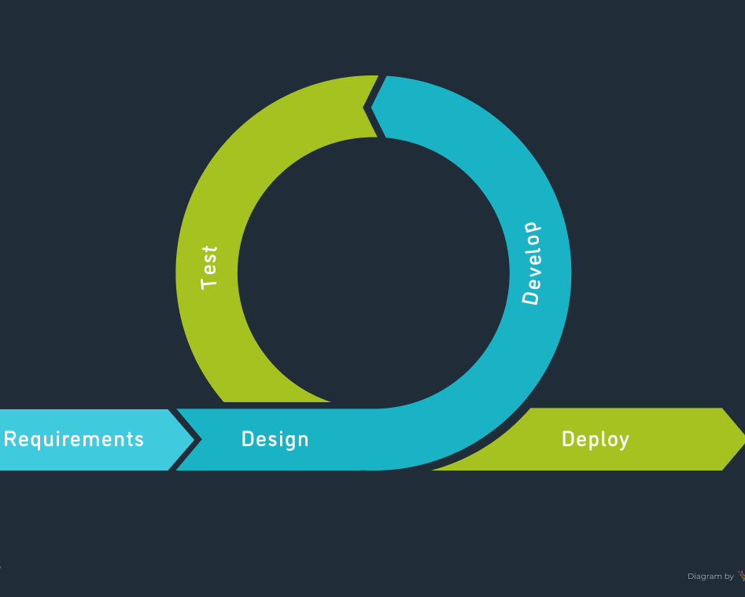
SDLC
Requirements
The beginning of the cycle, this is where you get the general idea of what is being asked.
Design
This is when you go more in depth and finish defining all the stages needed to complete.
Develop
Development begins with all members all hands on deck
Test
Testing occurs alongside development
Deploy
Final stage where product has met the standards of what is being asked and is released

Slide 4
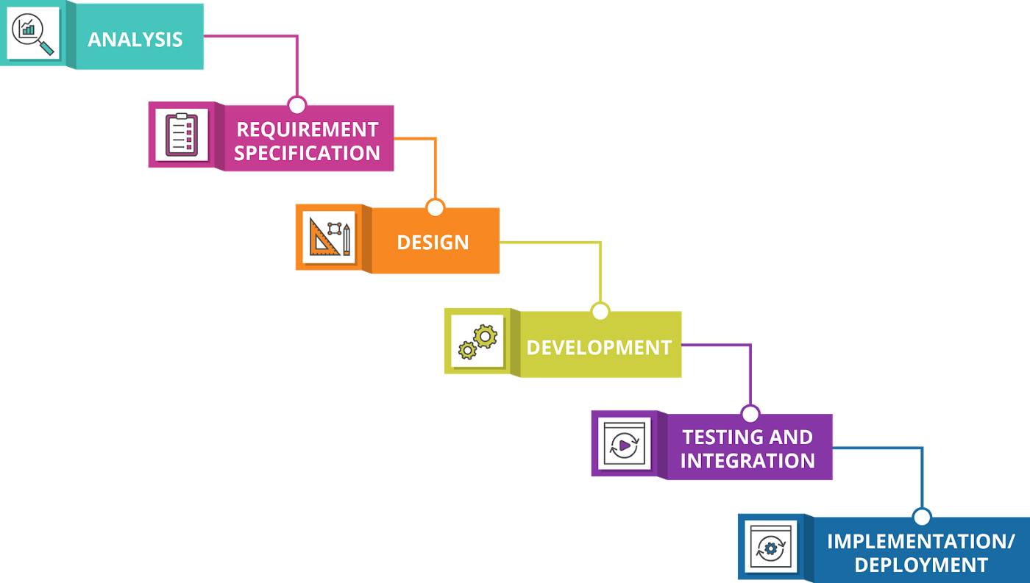

Agile Vs Waterfall
Agile
Waterfall
Agile was designed with change in mind
High Flexibility
Timeline can change depending on changes needed
Allows for feedback with clients and end user
Waterfall has a more rigid structure that struggles with change
Low Flexibility
Fixed timeline

Slide 5
Factors
I personally would nearly always consider an agile approach. Considering todays steady advancement with new technologies and ever-changing needs of the user, agile is just simply trumps the waterfall method in this day and age.

Slide 6
References
The 2020 scrum GUIDETM. Scrum Guide | Scrum Guides. (n.d.). Retrieved October 21, 2022, from https://scrumguides.org/scrum-guide.html
Virtasant. (2021, June 9). SDLC methodologies: From waterfall to agile: Virtasant. RSS. Retrieved October 22, 2022, from https://www.virtasant.com/blog/sdlc-methodologies
Waddell, J. +. (2019, April 23). The cascading costs of Waterfall. Medium. Retrieved October 23, 2022, from https://medium.com/@joneswaddell/the-cascading-costs-of-waterfall-5c3b1b8beaec
Hoek, J. van der. (2022, October 14). Agile explained: The 5 stages of the Agile Development Lifecycle. Mendix. Retrieved October 23, 2022, from https://www.mendix.com/blog/agile-software-development-lifecycle-stages/

